Slide 1


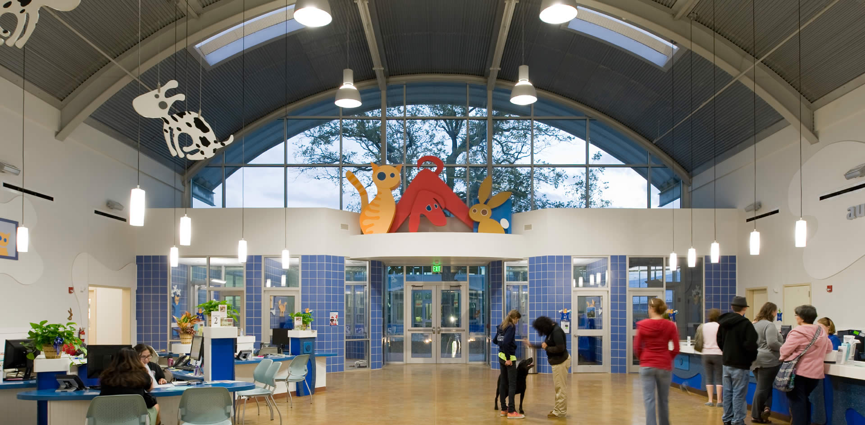



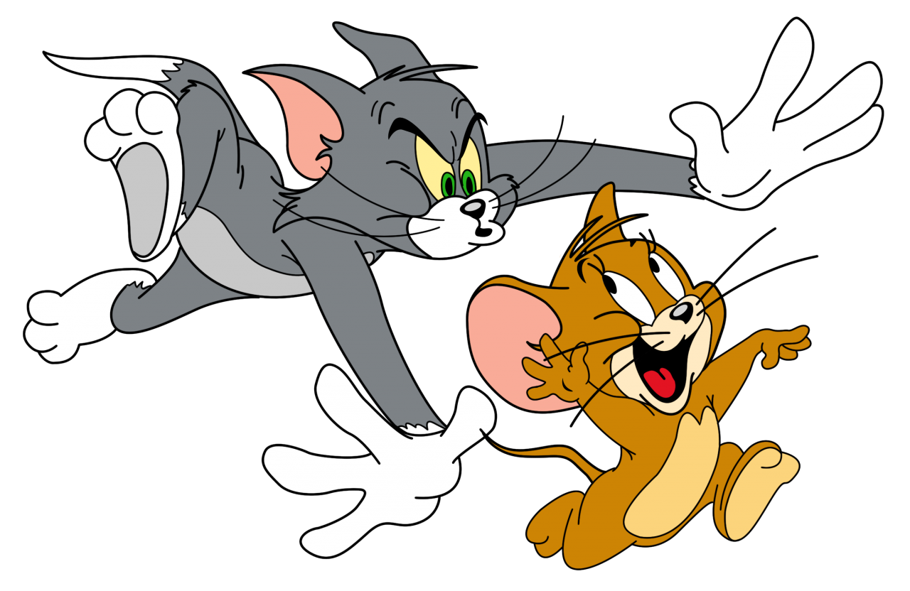
Austin Animal Shelter Analysis
Analysis of over 80,000 animal adoption intake and outcome data entries to predict the likelihood of adoption outcome
Prathima Bandi, Elijah Belizor, James Hook, Jack Kenning

Slide 2
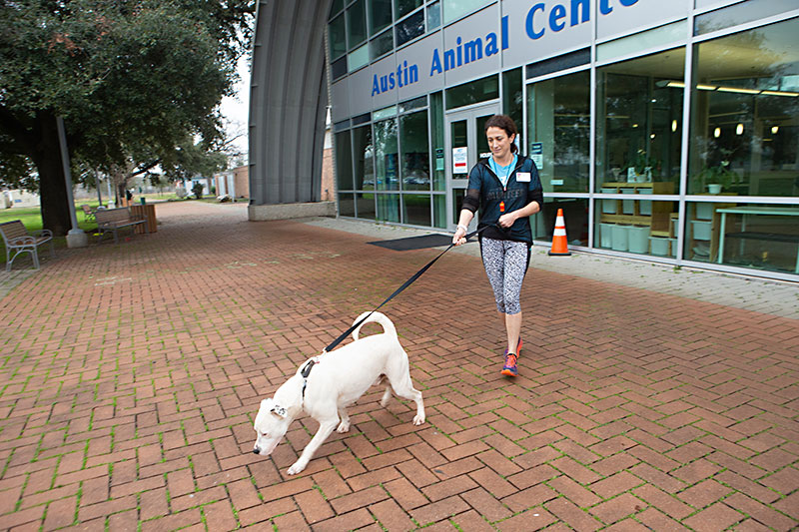
Study Overview
Austin Animal Center (AAC) is one of the largest no-kill animal shelters in the U.S, caring for over 18,000 animals per year
This study aims to explore which factors most influence adoption outcomes and whether there is a predictable pattern
Through a supervised machine learning model, the goal is to attempt to predict adoption outcome for animals based on multiple criteria

Slide 3
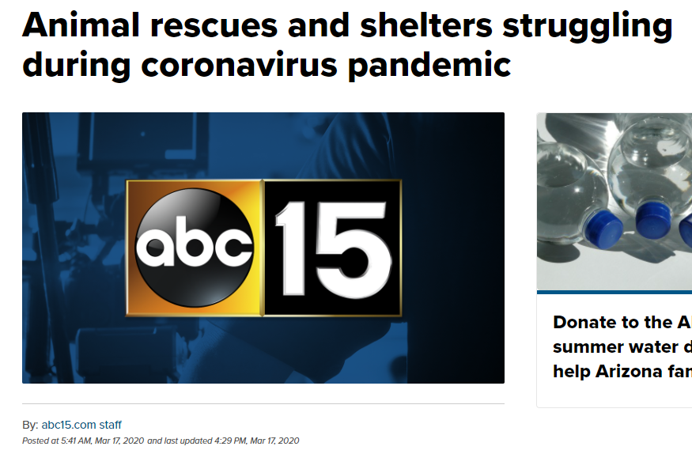
Why Analyze Animal Adoptions Data?
Potential to uncover useful insights to improve animal welfare in the area (and other regions)
Identify which types of animals may require additional support at shelters
Help prevent negative outcomes for identified high-risk animals
Assist with shelter resource, housing capacity, and budget planning
Shelters currently struggling to operate due to Covid-19 social distancing measures
Help inspire volunteer involvement in local animal welfare community

Slide 4
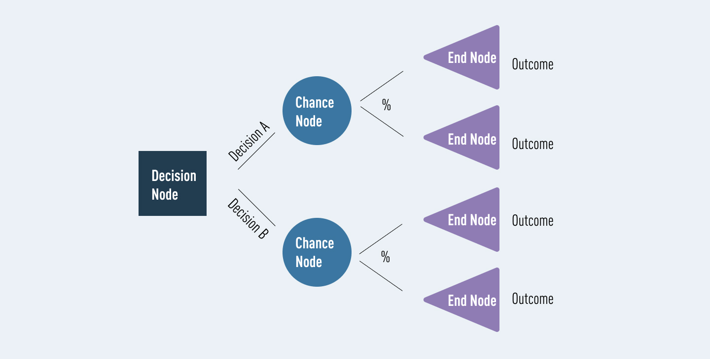
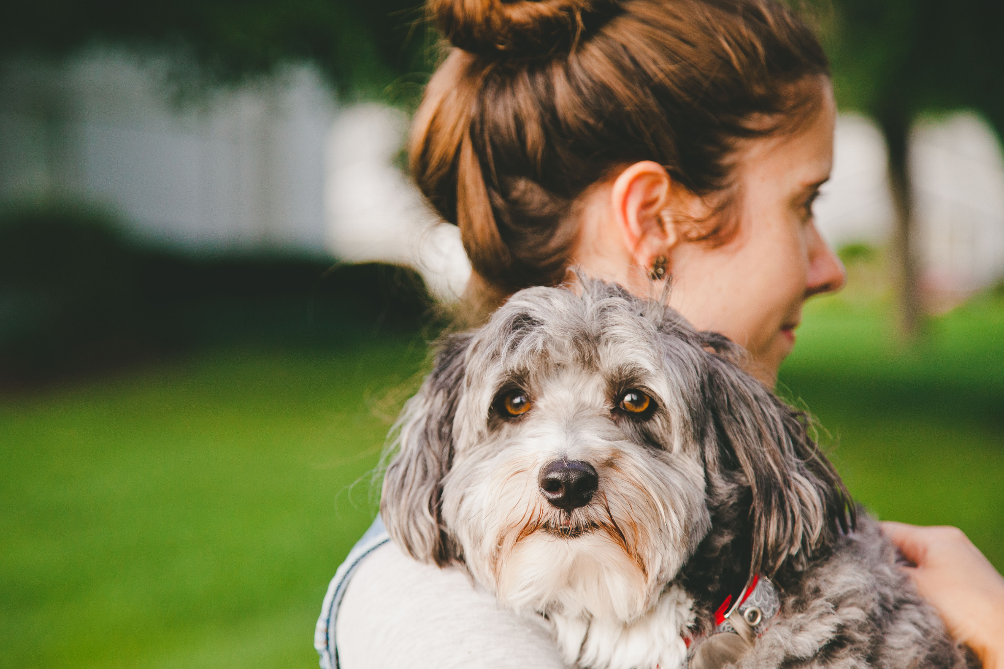
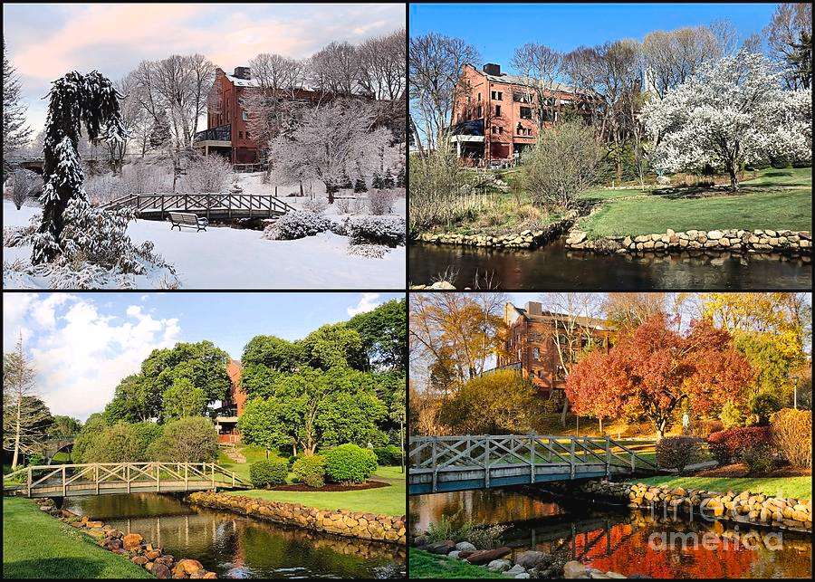

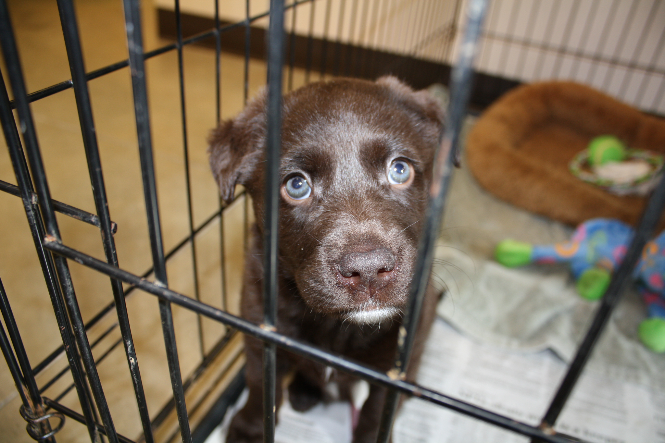

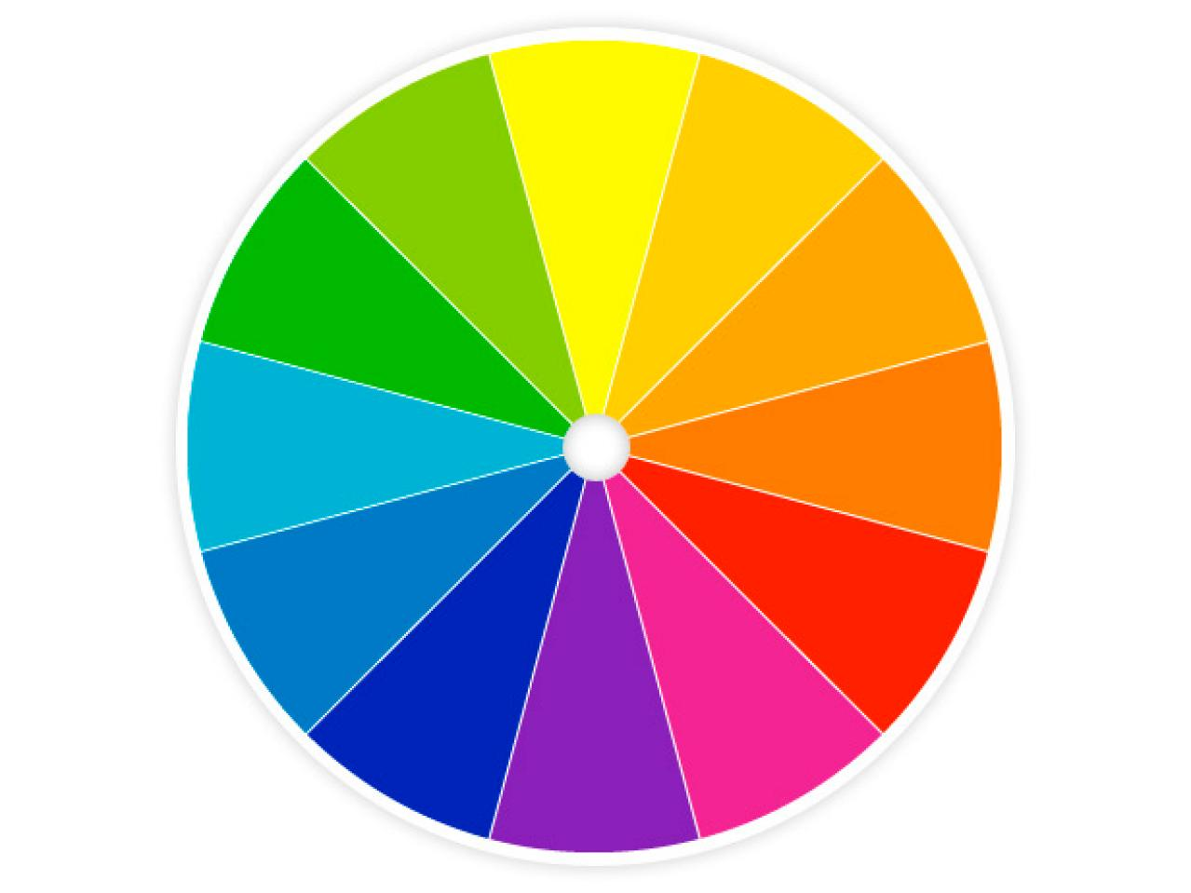
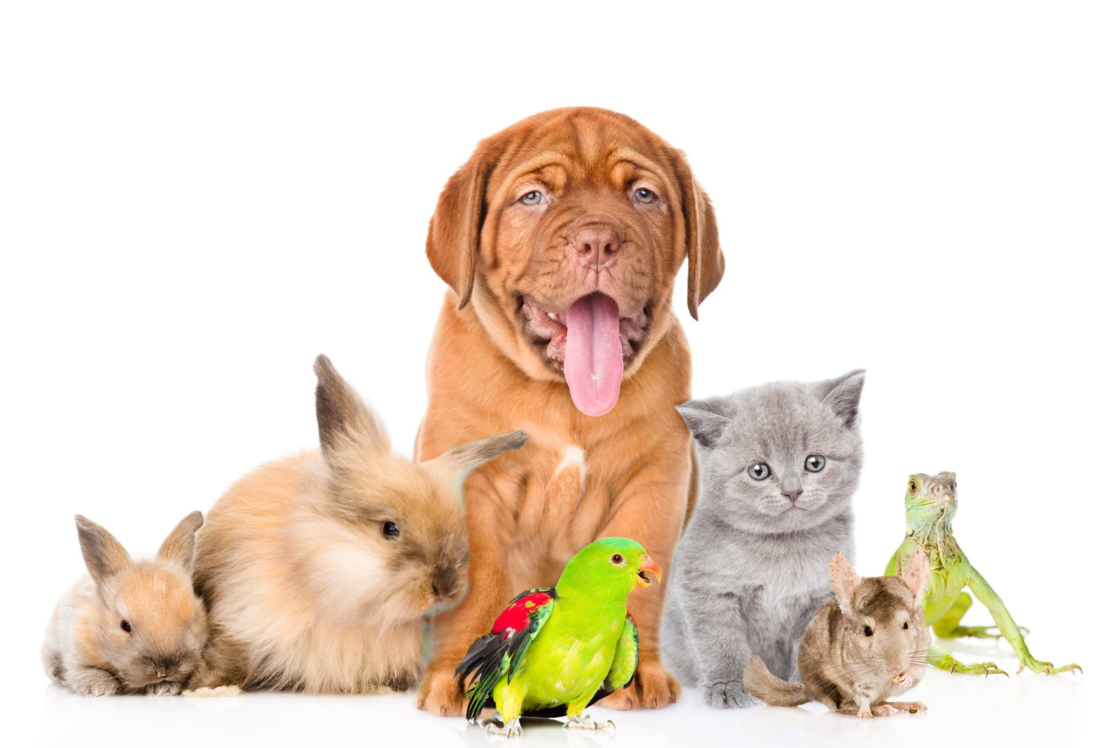
What Questions do we Hope to Answer?
Decision Tree Model Concept
- perfect for classification problems
Can a machine learning model be trained to effectively predict whether an animal will be adopted?
If not, what alternate model types might be more suitable to test?
What are the main factors controlling adoption intake and outcome for different animals?
Impacts of month of the year/day of the week on adoption outcome?
Impacts of animal specific traits on adoption?
What further analyses could be performed as future work?
ML Model Prediction
Explore & Characterize Trends
Animal more likely to be adopted (Outcome 1)
Temporal
predict vs.
By animal type
Animal less likely to be adopted (Outcome 0)
Other traits e.g. color
Time in shelter

Slide 5
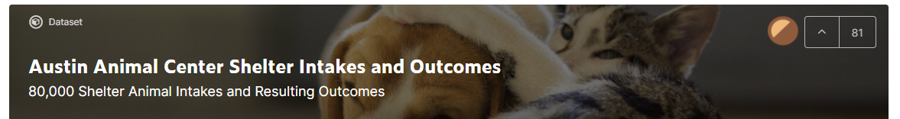

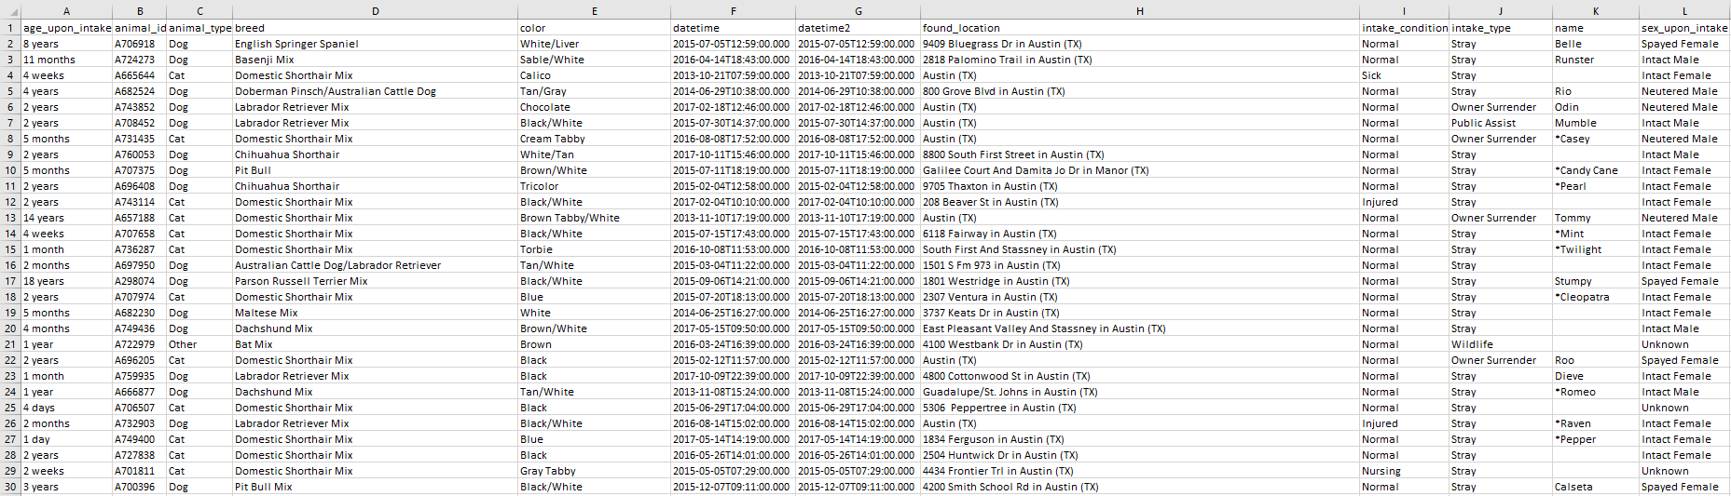
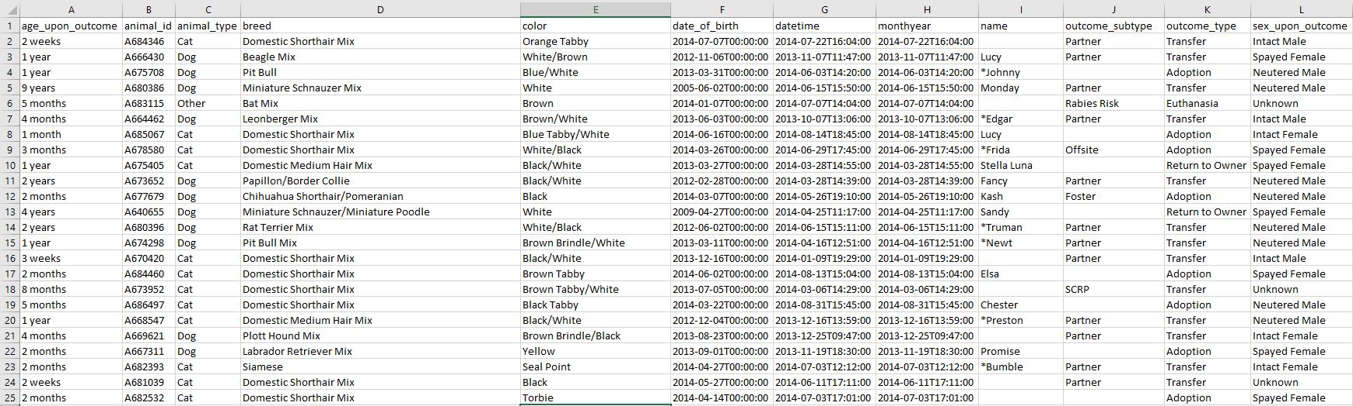
Where was the Dataset Sourced From?
Data sourced from a Kaggle dataset
Data publicly available as part of the City of Austin Open Data Initiative
Base dataset consists of separate tables for animal ‘intake’ and ‘outcome’ data, and a ‘merged’ table (latter used by team for study)
Dataset info:
Ranges from October 2013-2018
>80,000 entries, 12 columns
Time/date data to hourly frequency
Some animals enter/exit shelter multiple times
aac_intakes.csv
aac_outcomes.csv
Kaggle Dataset: https://www.kaggle.com/aaronschlegel/austin-animal-center-shelter-intakes-and-outcomes AODI: https://data.austintexas.gov/

Slide 6













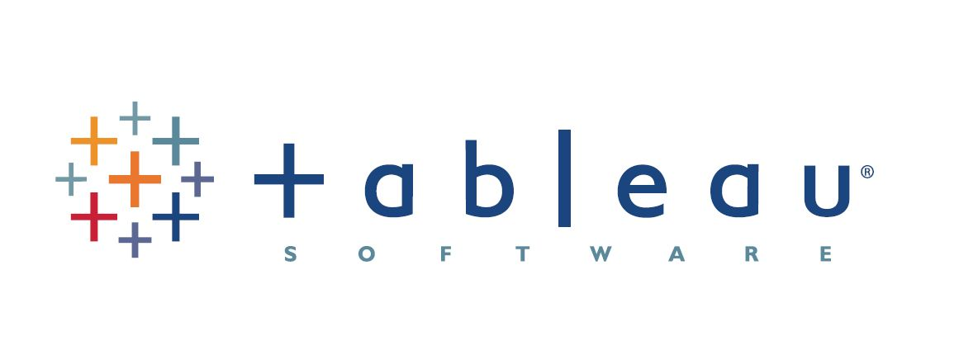
Tools and Resources Used By the Team
Software and Tools
Communication
Python - Language used for ETL, machine learning
Jupyter Notebook - Interactive development environment for Python
PostgreSQL - database storage
Slack - primary method of communication for day-to-day project needs and logistics
Zoom - bi-weekly check-ins/code review and for peer-assists
Pandas - ETL
SciKit-learn - Machine Learning library for Python
Seaborn/mpl - exploratory visuals
Text message - alternate/backup communication
Phone call - emergencies
Tableau - interactive dashboard
Github - project storage
Google slides - this presentation!

Slide 7
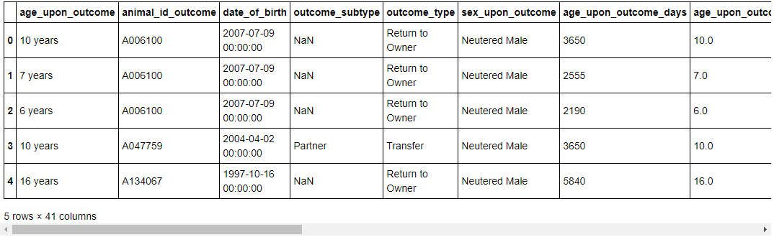
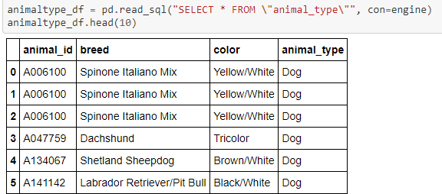
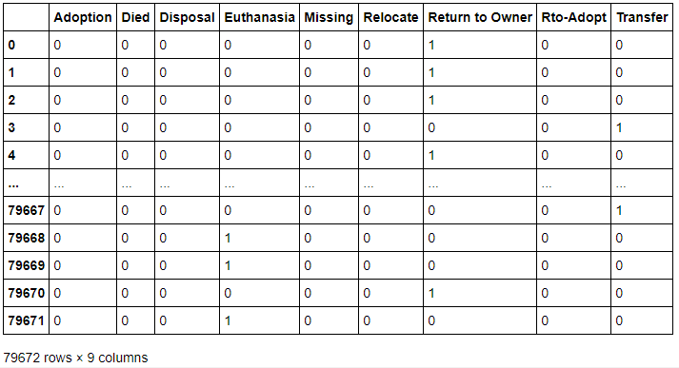
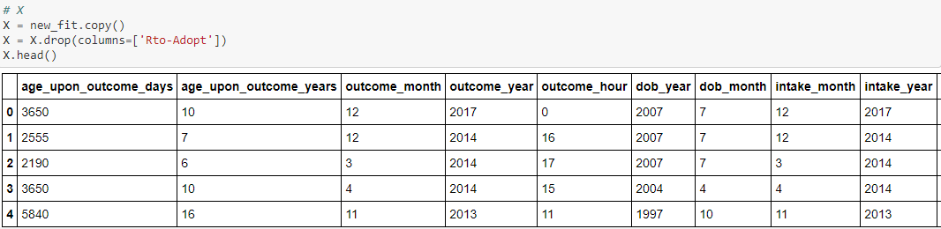
Pandas ETL Process Key Points Summary
1
2
Raw file that was brought into the database and renamed columns to match SQL format, made transformations
Animal lookup table created in SQL containing ‘static’ data types, animal_in_out table reduced to ‘changeable’ data (i.e. datetime entries)
3
4
Final transformations made (e.g. drop target column, and additional categorical variables encoded) for final dataset, then input to ml model
Both tables joined with a created id and dummies created for ml database target variable (outcome_type)

Slide 8
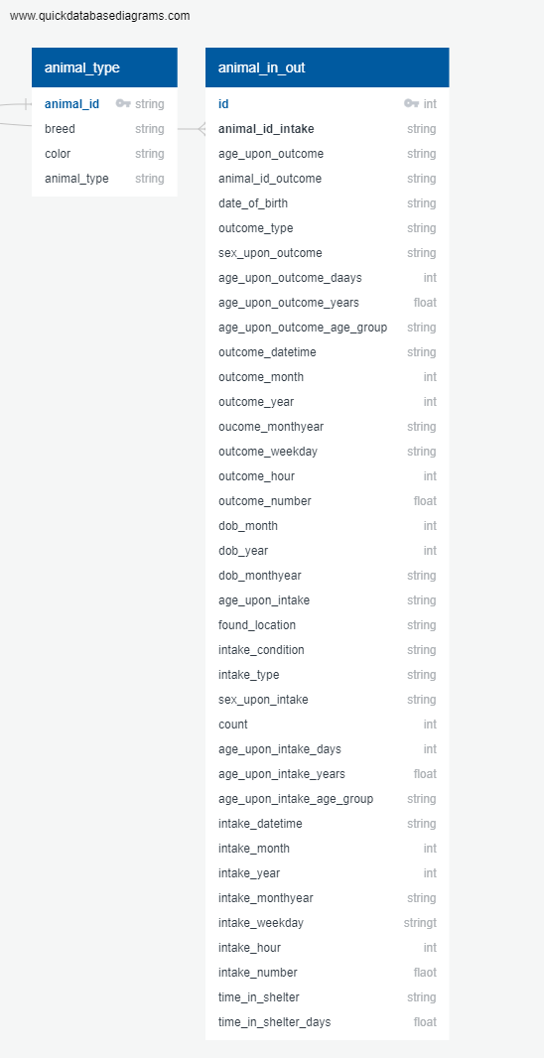
Data Exploration - SQL Database Creation Overview
‘Shelter_db’ created in PgAdmin
2) Database connection created with Pandas library to load in raw data
Postgres Database Schema - joined tables
‘animal_type’ lookup table - variables that remain the same for a specific animal
4) Copy created of raw data, transformations performed
3) SQL ‘Create’ script used to make master ‘animal_type’ table
‘animal_in_out’ table houses temporal data features that can change if an animal enters/exits the shelter multiple times
5) Created ‘animal_in_out’ table as dataset for analysis
6) Both data tables joined in the database

Slide 9
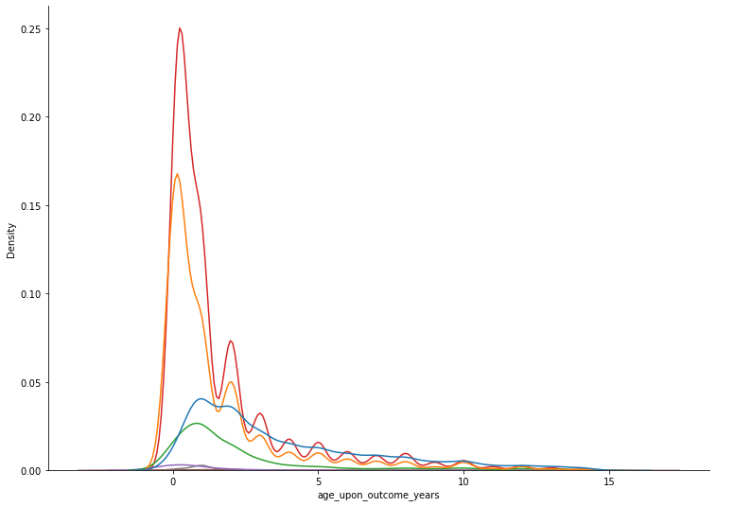
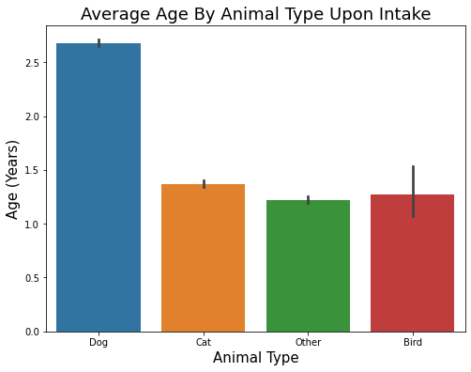
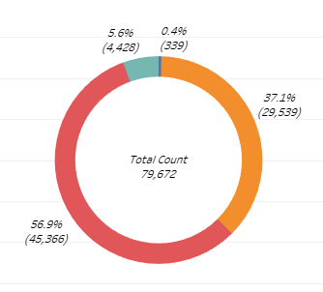
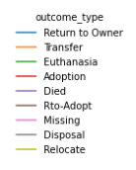
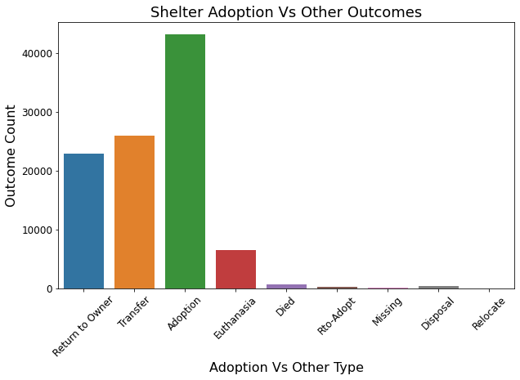
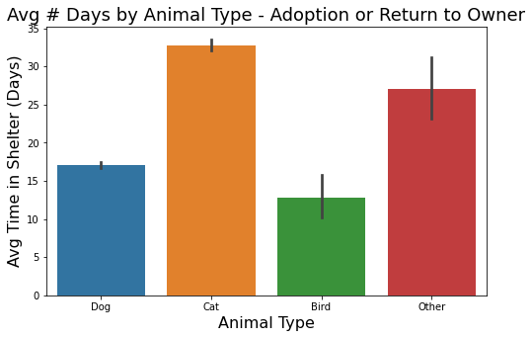
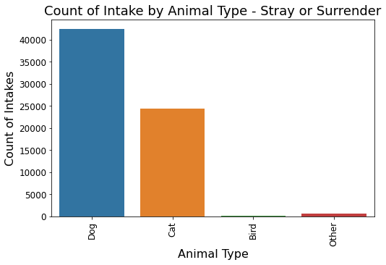
Dataset Overview - Exploratory Analysis
Count by Animal Type
Bird
Count by Animal Type
Other
Cat
Dog

Slide 10
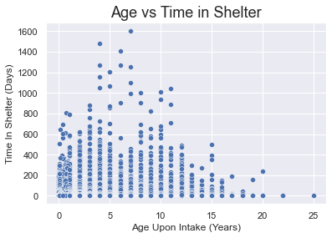
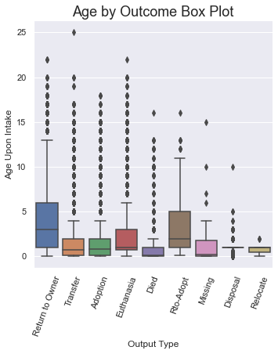
Impact of Animal Age and Time in Shelter on Outcome
Animals < ~4 years old more likely to be adopted or returned to owner quickly
Some animals more likely to be in the shelter for longer periods
Seems to be a combination of factors
Are older animals spending less time due to likelihood of adoption or other reasons e.g. death by old age, euthanazia etc.?

Slide 11
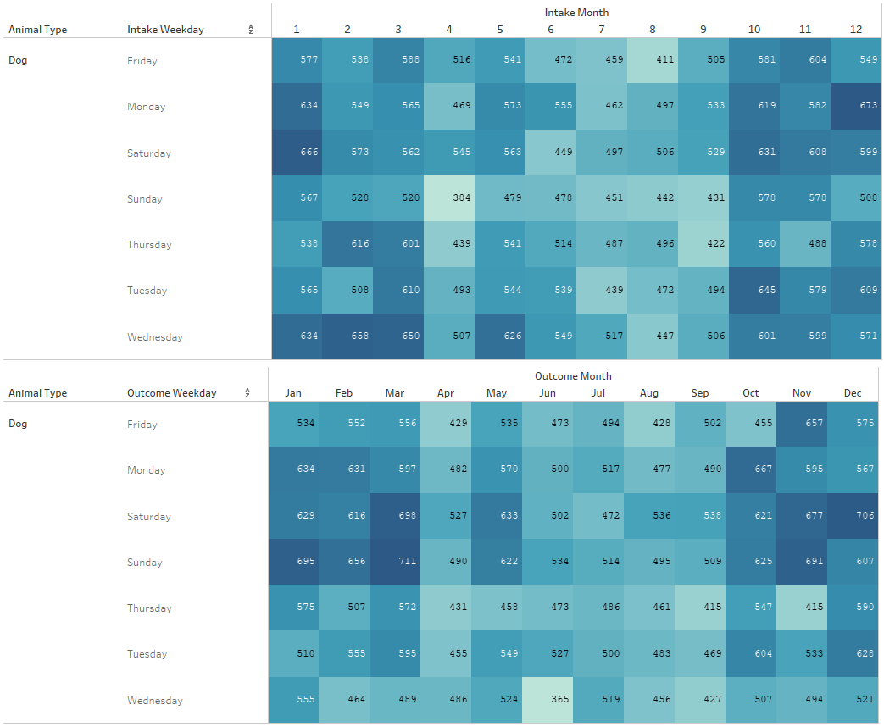
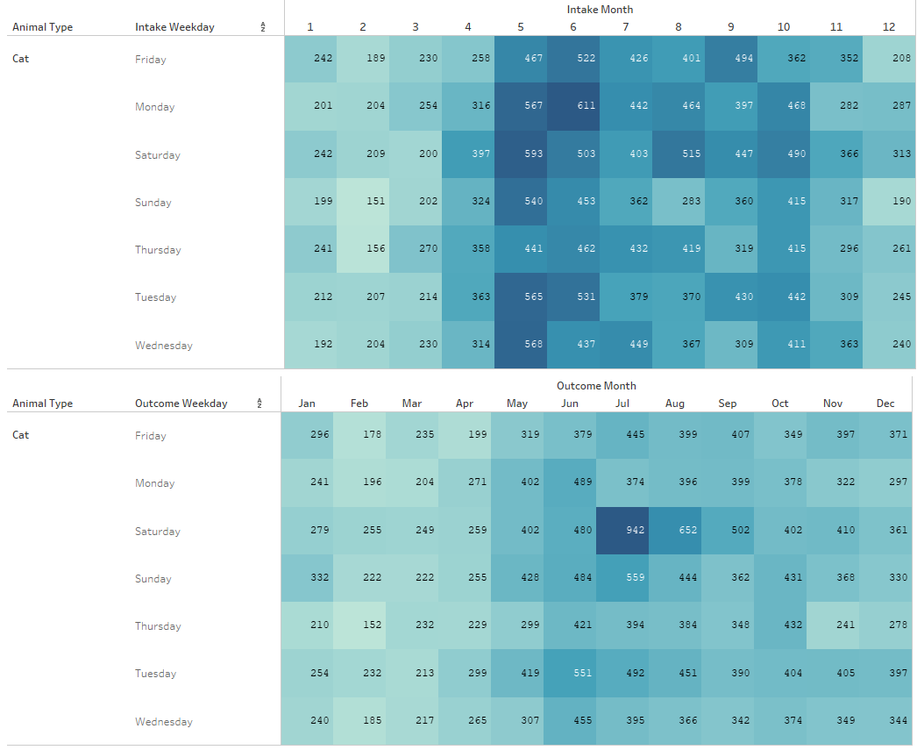
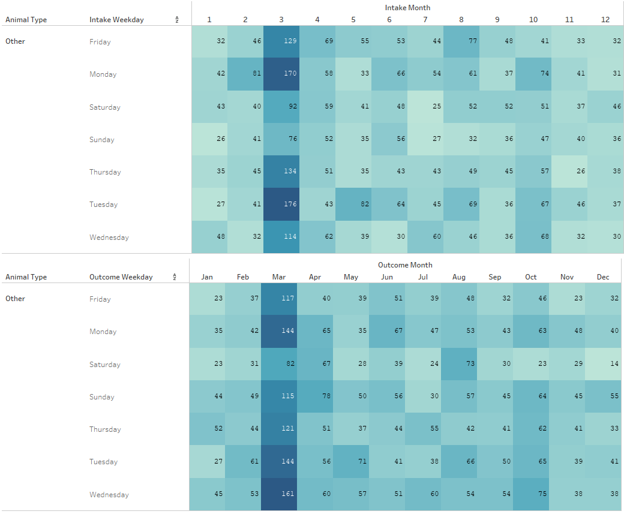
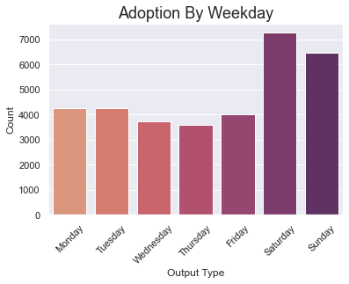
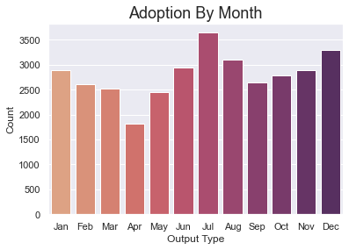
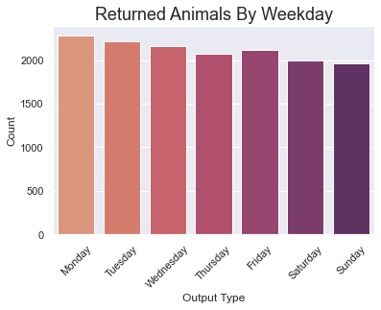
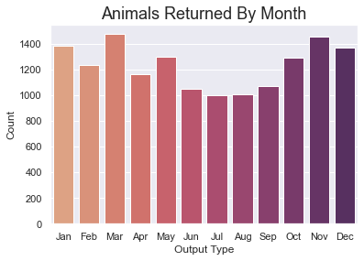
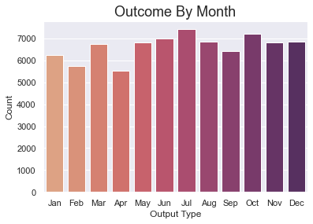
Monthly and Weekly Intake/Outcome Analysis
Day/Month Trends (“Dogs”)
Day/Month Trends (“Cats”)
Day/Month Trends (“Other”)
Overall Outcome Statistics

Slide 12
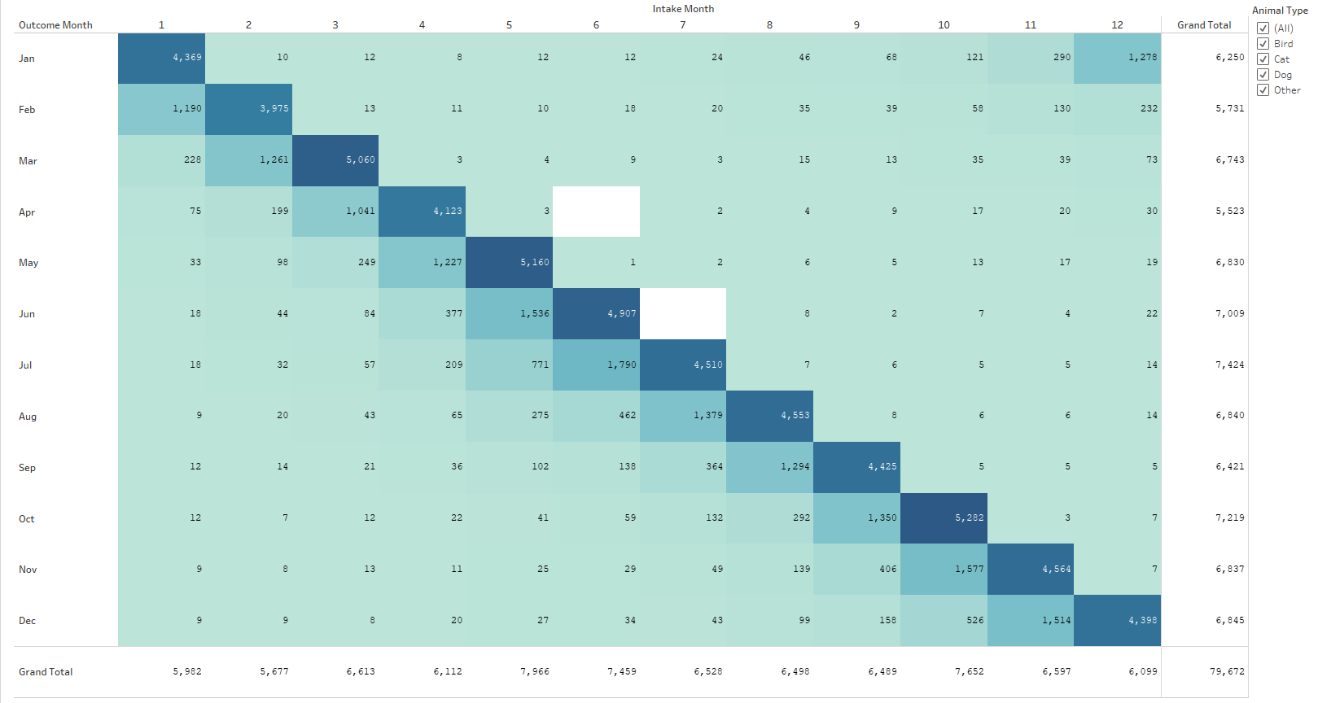
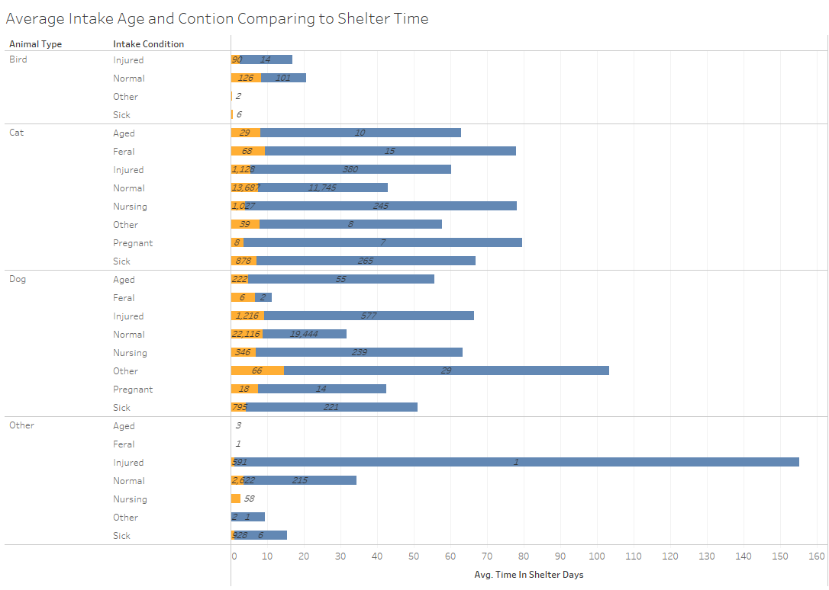
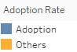
Intake vs. Outcome Overview

Slide 13
Machine Learning Model Creation Overview
1) Connect model to database
2) Preprocess data (encode categorical variables)
3) Define target variable
10a) Iterate with changes if necessary
5) Scale the data
4) Split data in Train and Test datasets
7) Fit the model with Training data
6) Plot the tree model
10b) Publish model results
9) Review confusion matrix, accuracy, classification report results
8) Make predictions from test data

Slide 14
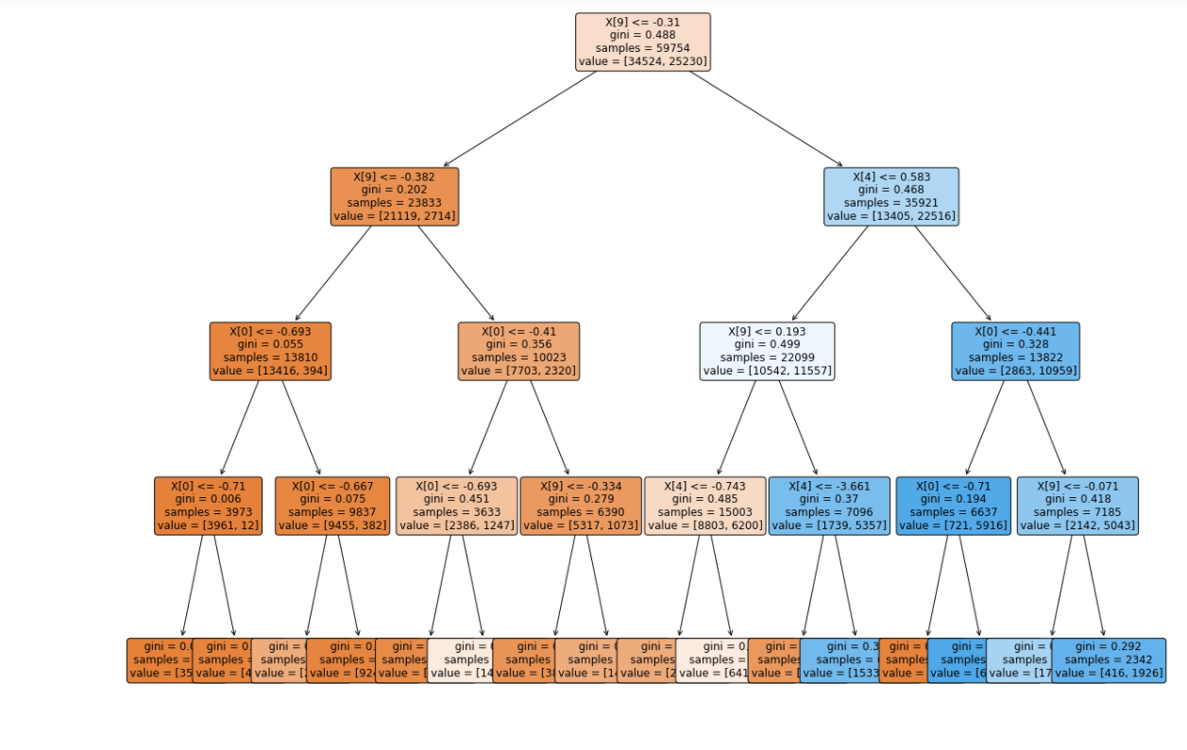
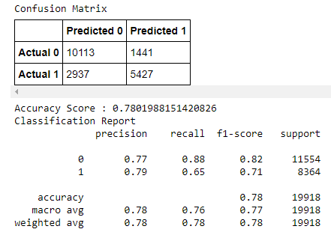
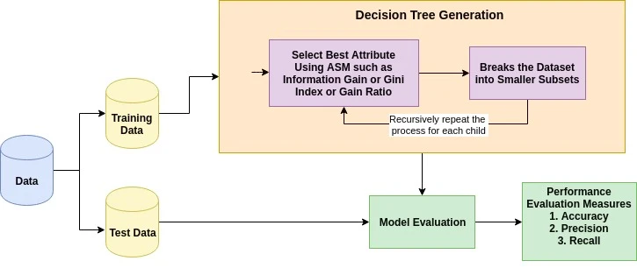
Machine Learning Model Analysis Results
Decision Tree Model Plot
Confusion Matrix and Classification Report
Adopted = 1
Not Adopted = 0
TN = True Negative
TP = True Positive
FN = False Negative
FP = False Positive
(TN)
(FP)
(FN)
(TP)
0.75 minimum target
Decision Tree Training Process
% of correct predictions
TP/(TP + FP)
% positive predictions correct
2*(Recall*Precision)/
(Recall + Precision)
% of positive cases caught TP/(TP + FN)
Notes:
Plot of the current iteration of the decision tree model. The goal is to progressively split and separate samples with a more similar structure that will result in more pure subsets of data.
The tree ends up with a series of branches (i.e. questions and answers) that eventually lead to a classification prediction representing a probability of a particular outcome.
Confusion matrix and classification report. The model currently achieves accuracy 78% which is just above our minimum accepted threshold of 75%. However further iterations may be able to improve the model performance.
A decision tree may not be the best type of model for this analysis, it is possible that superior results may be possible with a Random Forest model.

Slide 15
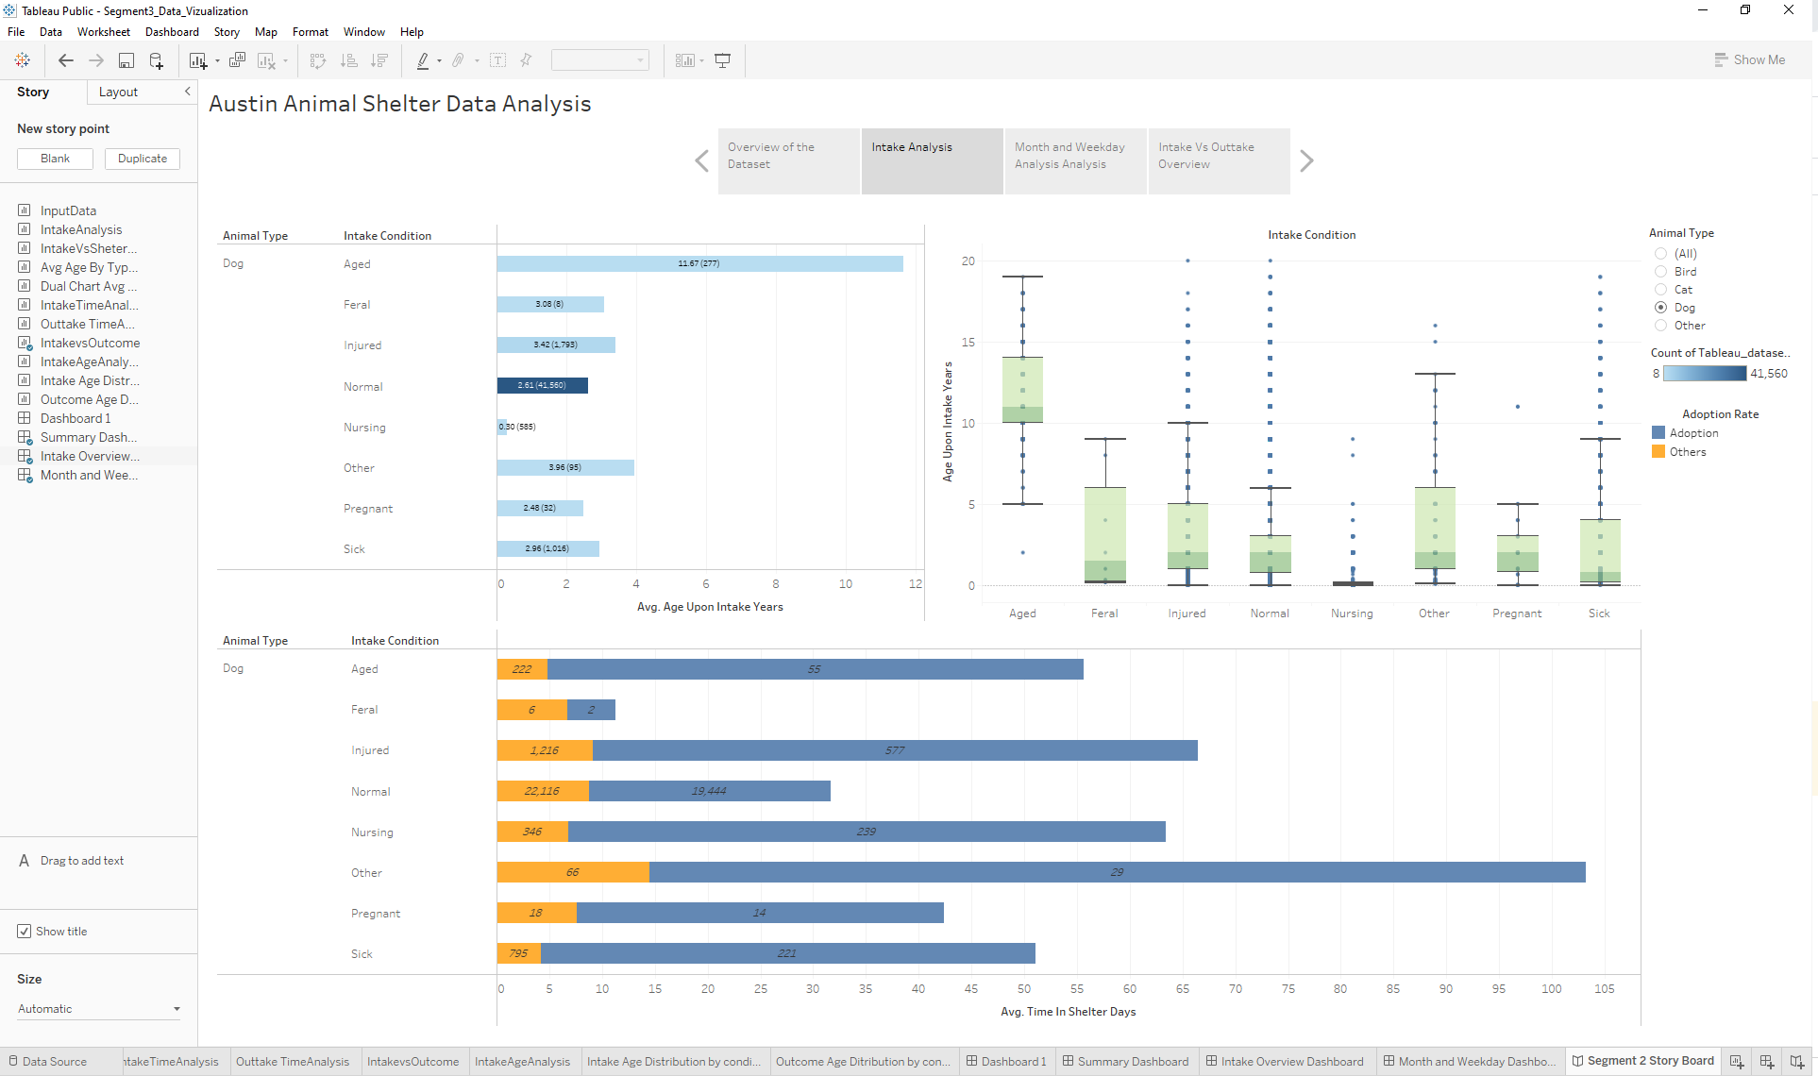
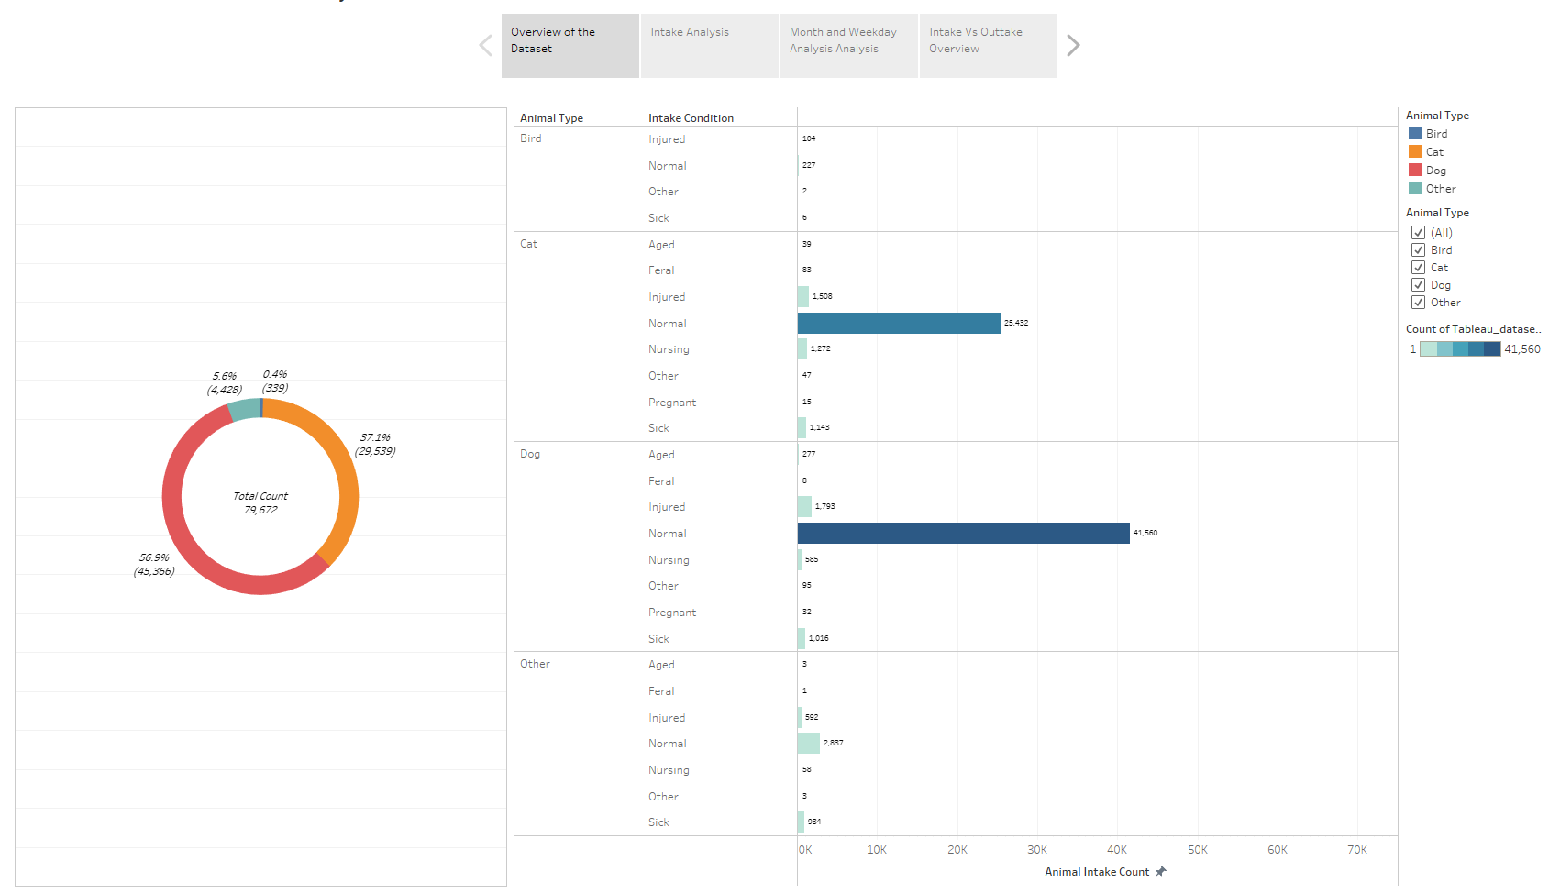
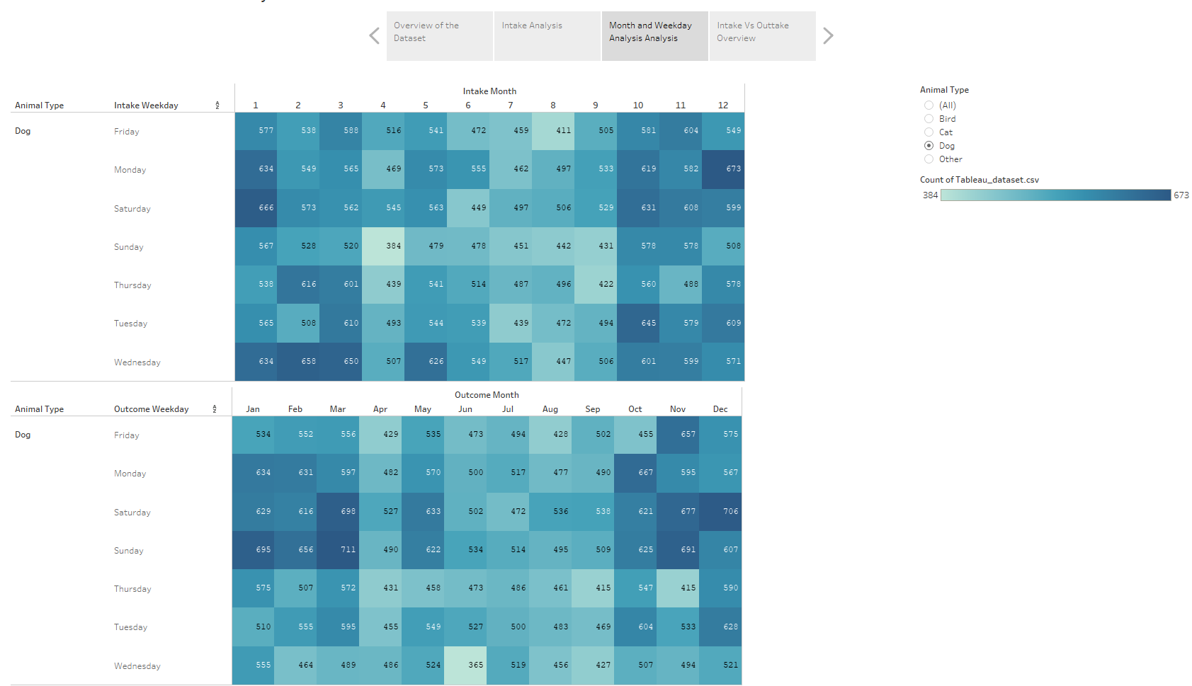
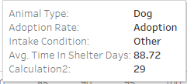
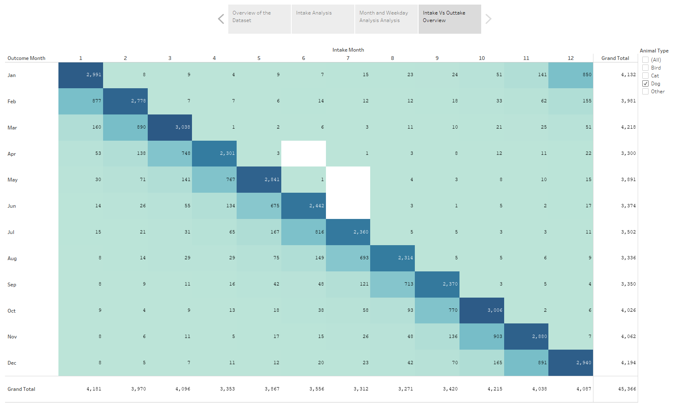

Results Visualized Using Interactive Tableau Dashboard
Interactive tabs to switch display topic
Selection reticle allows filtering by criteria, such as animal type
Tab 1 - Overview
Storyboard format to switch between multiple dashboard displays is user friendly
Tab 3 - Month/Day
Tab 2 - Intake Analysis
Tab 4 - Intake/Outcome
Mouse over tooltip to highlight chart data
Tabs to visualize individual components of the storyboard
Link to Dashboard: https://public.tableau.com/app/profile/prathima.bandi/viz/Segment3_Data_Vizualization/Segment2StoryBoard

Slide 16

Summary and Conclusions
Machine Learning Model Performance
Decision Tree ML model is able to predict adoption outcome (78%) above minimum target accuracy threshold (>75%)
Suggests variables are able to indicate adoption outcome
But, performance likely limited by current dataset/model
Key Exploratory Analysis Findings
Majority of animals receive an “outcome” within 1-2 months of entering the shelter
Majority of adoptions occur at the weekends and in summer months (except December - animals as xmas gifts?)
Most animals are returned at the start of the week and in winter months (particularly March - xmas link?)
Cats are the second most numerous animal type and most likely to be in the shelter for longer
Most animals adopted or transferred are under 2 years old, older animals are just as likely to be returned to owner as adopted
Older animals spend less time in the shelter due to a combination of different factors/outcomes
Recommendations for Future Work
Explore use of Random Forest as alternate ML model - potential to improve performance?
Further research to examine potential reasons behind observed trends
Additional analysis to explore relationships/links between variables
Random Forest model
- combine multiple decision trees

Slide 17
Backup

Slide 18
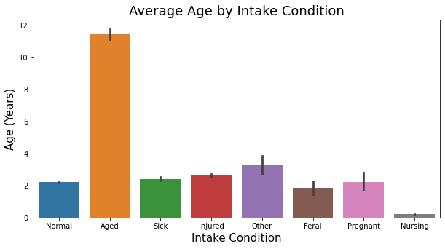
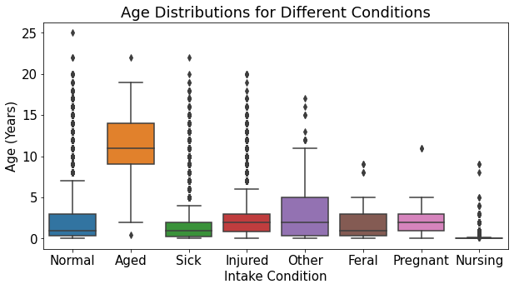
Exploratory Analysis - Animal Age Trends
Most animals adopted or transferred are under 2 years old, older animals are just as likely to be returned to owner as adopted
Unsurprisingly the the average age on intake condition is highest for animals classified as ‘aged’, other conditions are more or less even by comparison
On average dogs are older than other animals upon intake probably due to their longer lifespan

Slide 19
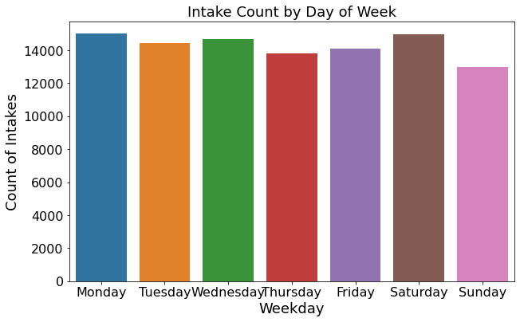

Exploratory Analysis - Intake Date/time Trends
Sunday is the least likely day that an animal will enter the shelter, followed by thursday and friday. Intakes are high at the start of the week from mondays, and also highest on saturdays
Early summer months in may and june see increased intakes counts for animals as well as approaching winter in october

Slide 20
Exploratory Analysis - Outcome Date/time Trends
Saturday and sunday are most popular days to adopt
Animal returns more likely at start of the week, decreasing throughout
Adoptions most common in the summer, also end of the year (xmas?)
Most animals returned in winter months
Fewer overall ‘outcomes’ in first quarter of the year

Slide 21
Exploratory Analysis - General Insights
Adoption is the most likely outcome for an animal overall by almost a factor of 2-1. However significant numbers are returned to owner or transferred. Other factors make up comparatively smaller proportion of outcomes - may decide to try to group when iterating ml model ?
Cats and miscellaneous other animals will generally spend the most time in the shelter compared to dogs and birds
Dogs are the most likely animal to be taken in as a stray or surrendered, followed by cats

Slide 22

Exploratory Analysis - Adoption Outcomes by Animal Type
Dogs are the most common animal at the shelter and most likely to be adopted, with many returned to owner or transferred
Cats are most likely to be transferred but almost as many are adopted, relatively few returned to owner
Miscellaneous other animals are most likely to be euthanized compared to any other outcome
Birds are uncommon at the shelter and a mostly a mix transfer, adopted, and euthanized

Slide 23
Storyboard for Tableau Dashboard Outline
Data count and selection tool makes sense to start
3
Temporal impacts on intake and outcome
4
Age specific controls on intake and outcome
1
2
High level overview charts of data
Total animal count
Selection menu (dropdown or checkbox combo filters for each variable in dataset - controls all relevant chart displays)
Pie chart showing counts by outcome type
Heat map of outcome type count vs days of the week
Age upon intake vs. count per outcome type (multi-line graph)
Age upon outcome vs. count per outcome type (multi-line graph)
Total currently selected animal count
Animal type intake count part-to-whole chart
Heat map of outcome type count vs months of the year
Adoption outcome is target variable and most important to see relationships with all other variables, multiple smaller charts here need to be heat maps as vs. categorical variables remaining
5
Multiple correlation matrixes/heat maps or linear plots for adoption outcome type count vs each variable (animal type, breed, color, age on intake, age on outcome, sex on intake, sex on outcome)
Data table mini-inset (results filter based on selection menu above, searchable/scrollable)
Animal type vs. time in shelter bar chart
Time in shelter vs. count per outcome type (multi-line graph)
Data table
Selectable Tabs in Tableau to further explore
Tabs for each individual chart
6
Dashboard
Story

